Slide 1



Sentiment Analysis
Unlocking Insights from Social Conversations on X (formerly Twitter)
1
16.01.2025

Slide 2






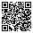
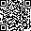
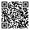
THE TEAM
Bojan Mircheski
Hashim Khan
Tristan Mertins
Marketing Ops/Rev Ops/ Data Analyst
PhD Student/Data Analyst
Online Marketing/Advertising Data Analyst
2

Slide 3



Agenda
Motivation
Objective and Method
Stakeholders
Trends
Data Preparation
Sentiment Analysis
Reccomendations
Future Work
3

Slide 4
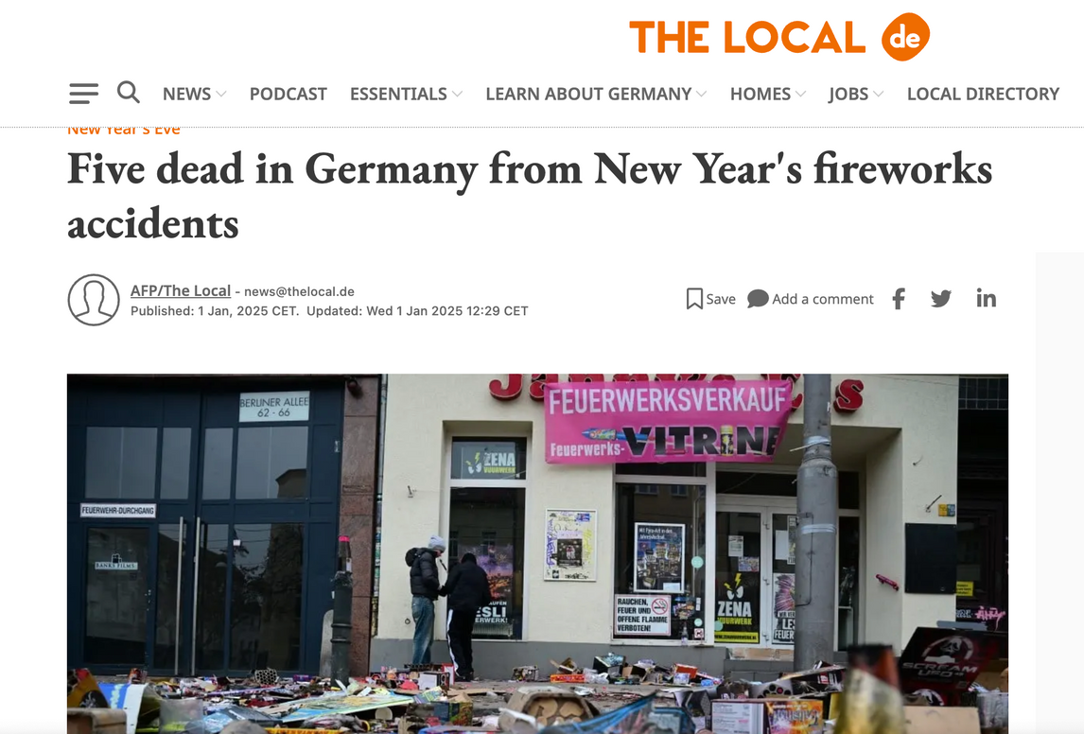
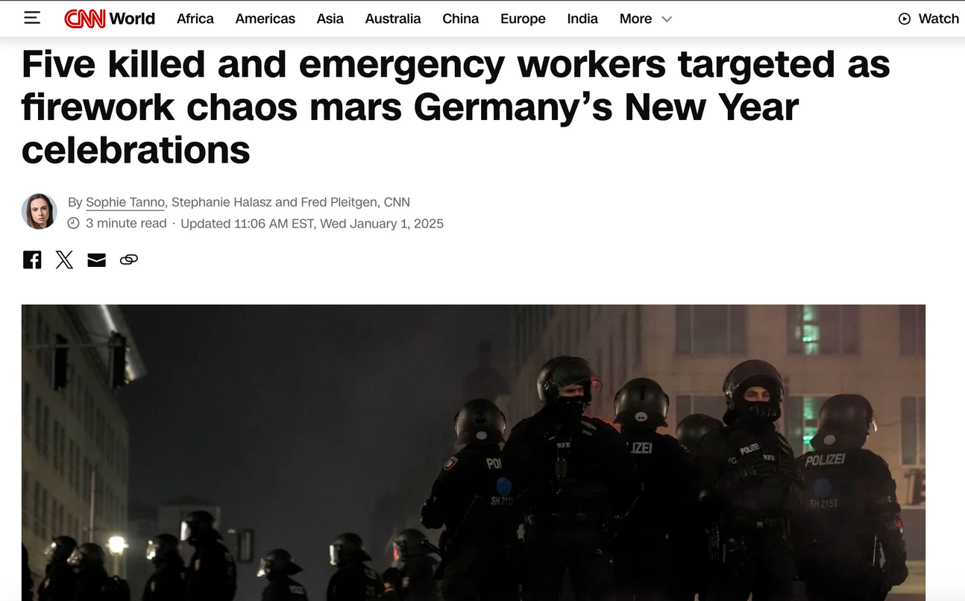
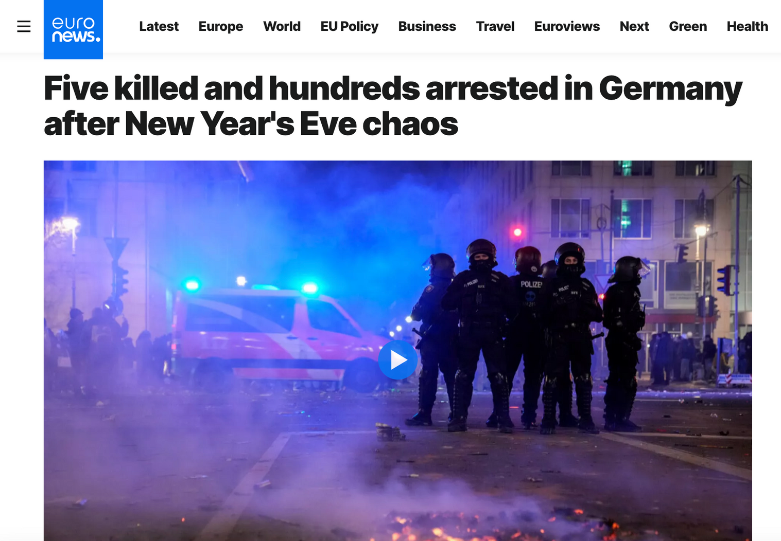

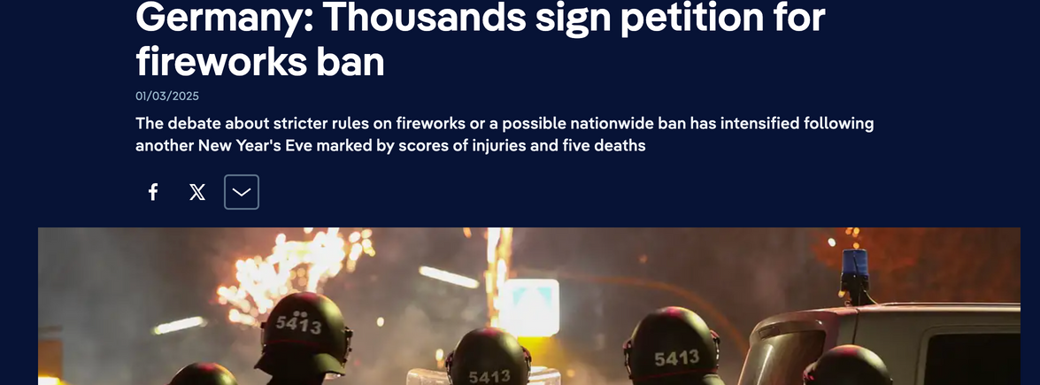
Explosive Motivation
4

Slide 5

Public Sentiment
Objective: X Public opinions
Method: Examine user-generated content to gather insights
Focus Areas:
Prevailing opinions about the fireworks
Relevant patterns and trends
5

Slide 6
Stakeholders
Environmentally Focused Groups:
BUND
NABU
Berliner Klimatag Community Groups
General Community Groups in Germany:
Stadtteilvereine Nachbarschaftshilfe Deutschland
Freiwillige Feuerwehren
Animal Welfare Organizations:
Deutscher Tierschutzbund
Berliner Tiertafel
6

Slide 7

Steps to be followed
Before Beginning Sentiment Analysis
TREND IDENTIFICATION | DATA COLLECTION | DATA STORAGE | CLEANING AND PREPROCESSING | TRANSLATING
-Relevant trending hashtags or keywords using Twitter trending sites | -Scraping Tweets Use APIs (e.g., Twitter API) | -Saved as a CSV-file | -Remove irrelevant content -Remove duplicates -Summarize/ adjust locations -Merge the files | -Tokenize -Translate into English
7

Slide 8

Trend Identification
Böller
Kugelbombe
Feuerwerk
Silvester
8

Slide 9
Data Collection
Data Collection: Tweets scraped via Python script
Tools Used: Tweepy library+ X API + X Developer Account
Free Account Limitations:
Max 100 tweets/month
Data from last 7 days only
Solution: Multiple X Developer Accounts created
9

Slide 10
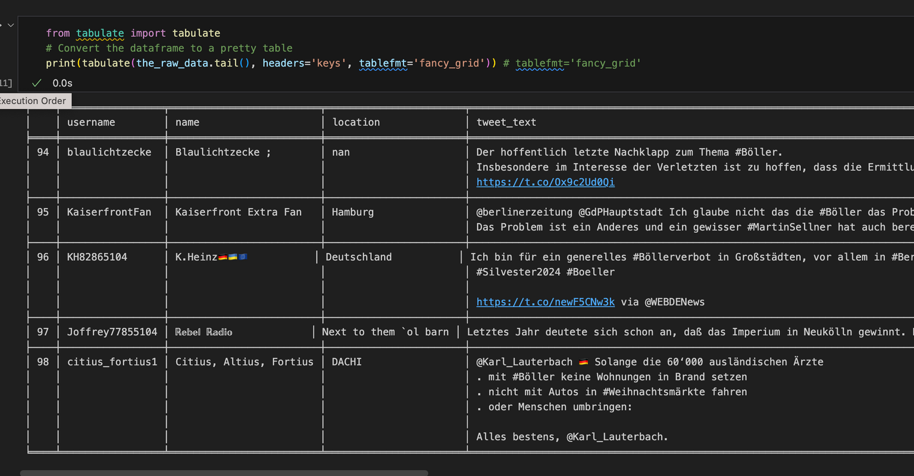
Extracted Data
10

Slide 11

Cleaning the Data
Removed irrelevant content
Removed Emojis
Removed duplicates
Summarize/ adjust location data
Merged the files
11

Slide 12
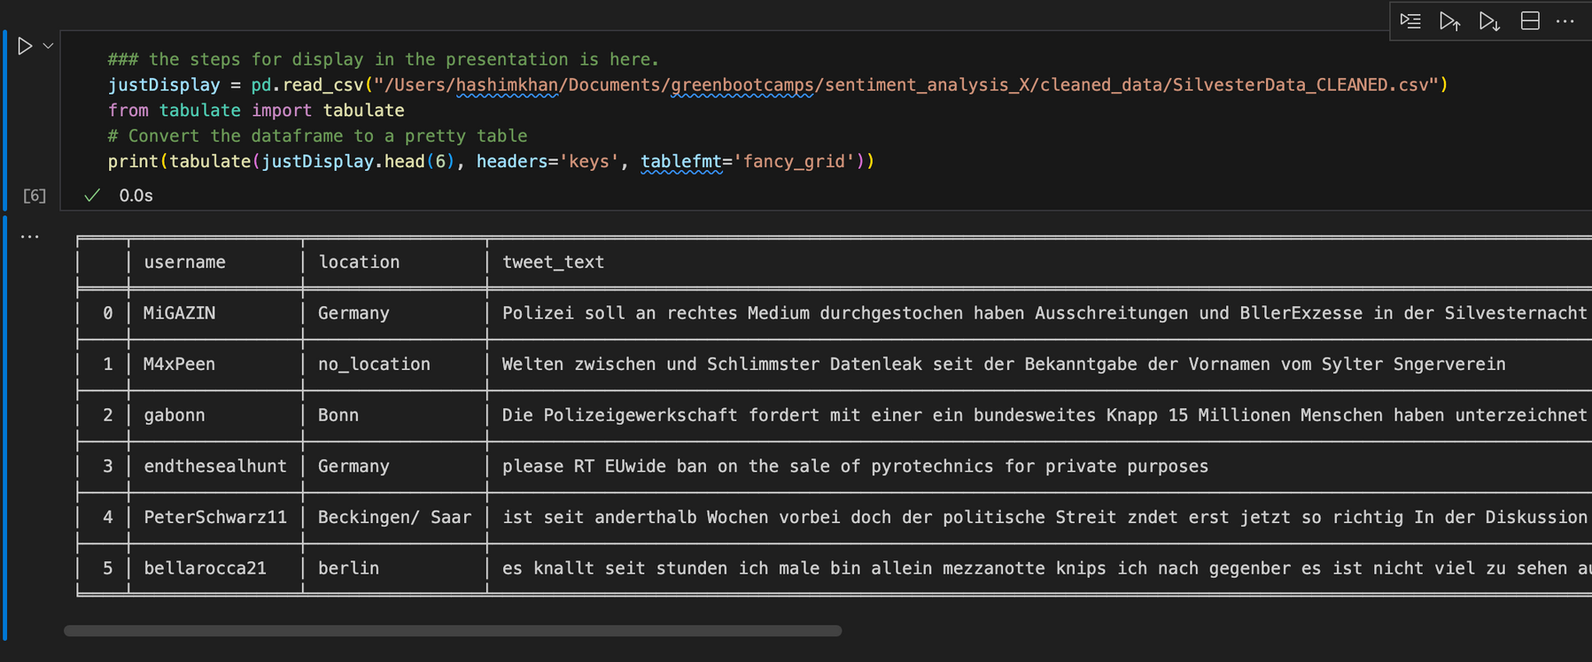
Cleaned Data
12

Slide 13
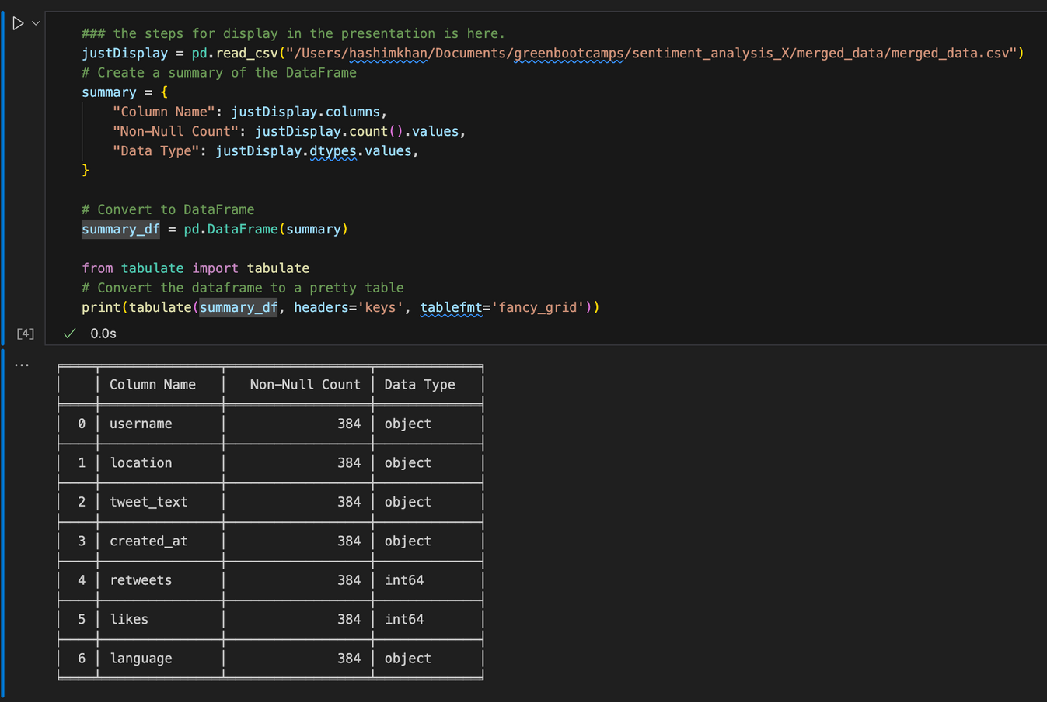
Merged Data Summary
13

Slide 14

Translation
Components:
MarianMTModel:
A pretrained sequence-to-sequence model for translating text between languages.
Optimized for specific language pairs, e.g., German to English (de-en).
MarianTokenizer:
Prepares input text for the MarianMT model by:
Tokenizing text into subword units.
Adding special tokens.
Converting text into numerical format for model processing.
14

Slide 15
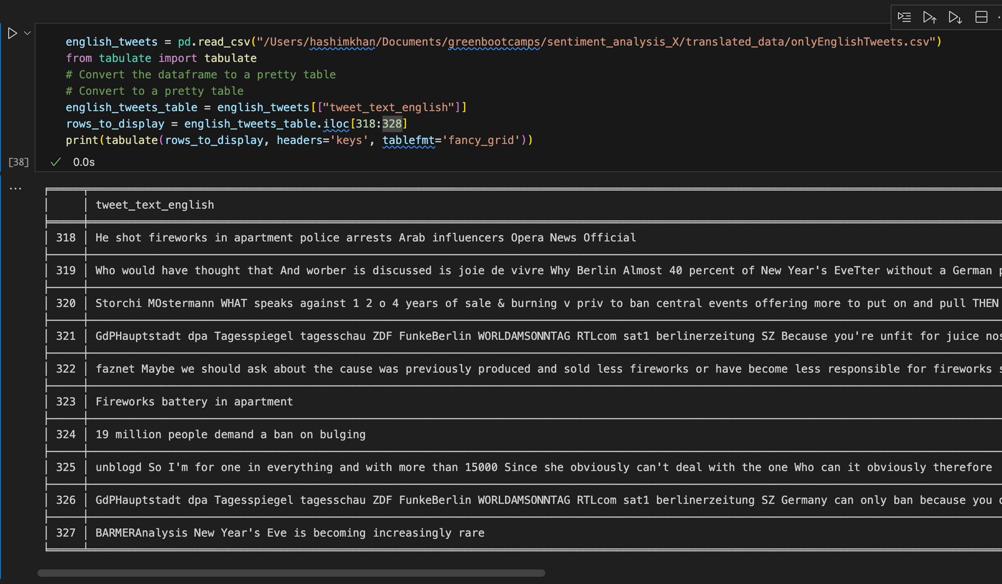
Translation Function
def translate_to_english(text):
"""
Detect language and translate text to English if it's in German.
"""
try:
lang = detect(text)
if lang == "de":
# Prepare input for the model
inputs = tokenizer.encode(text, return_tensors="pt", max_length=512, truncation=True)
# Generate translation
outputs = model.generate(inputs, max_length=512, num_beams=4, early_stopping=True)
# Decode and return translated text
translated_text = tokenizer.decode(outputs[0], skip_special_tokens=True)
return translated_text
else:
return text
except Exception as e:
return f"Error: {e}"
15

Slide 16
16

Slide 17
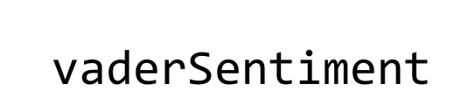

Sentiment Analysis
Sentiment Analysis Process
Library Used: for sentiment scoring.
Steps Taken:
Initialization: Created a instance.
Sentiment Scoring:
Applied analyzer.polarity_scores on each English-translated tweet to calculate the compound score.
Sentiment Classification:
Labeled tweets as:
Positive: Compound score > 0.05.
Negative: Compound score < -0.05.
Neutral: Compound score between -0.05 and 0.05.
Data Integration: Added the calculated sentiment scores and labels as new columns in the dataset (Sentiment and Sentiment_Label).
17

Slide 18
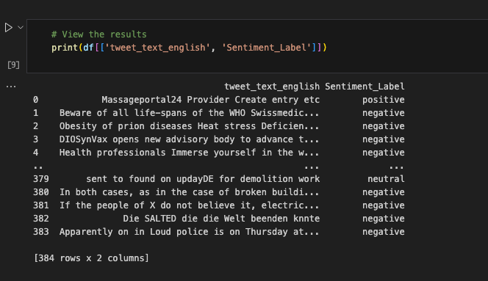
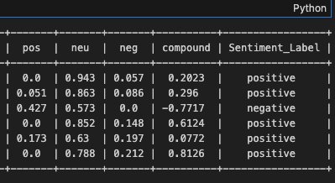
18

Slide 19

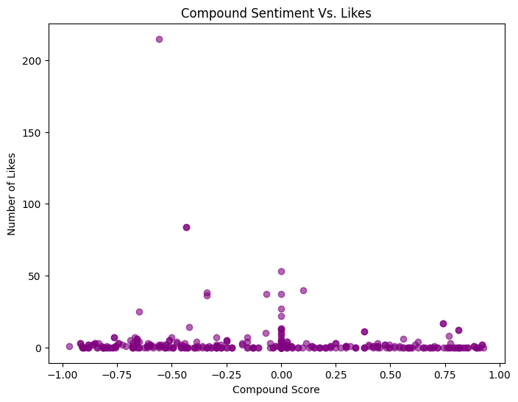
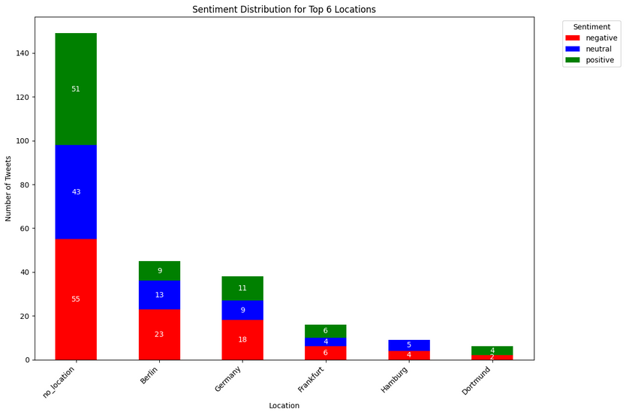
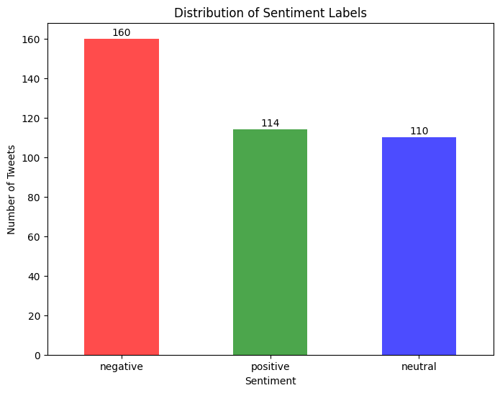
Compound Score Vs.
No. of likes
Top 6 locations based Sentiment statistics
Count of Sentiment
Labels
19

Slide 20
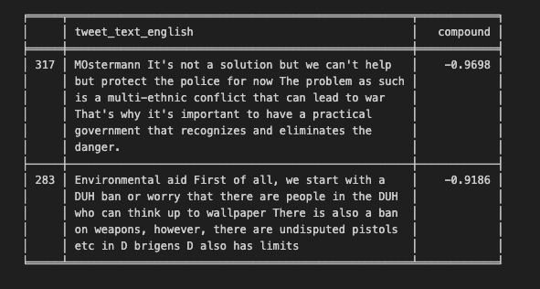

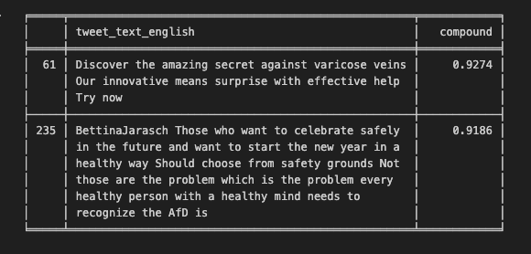
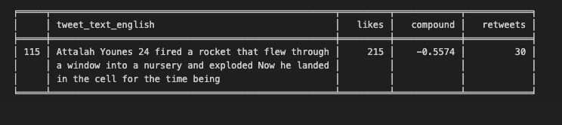

Most Negative
Most Positive
Most Likes and Retweets
20

Slide 21



Thank You For Your Attention!
21

